Slide 1
ATM Interface
Presented by: M . Praveenkumar
Enrollment No : EBEON03251076725
Batch : 2024-14789

Slide 2
Objective
To create a console-based simulation of an ATM system using Java OOP principles.
Users can log in using their ID and PIN to perform banking operations.

Slide 3
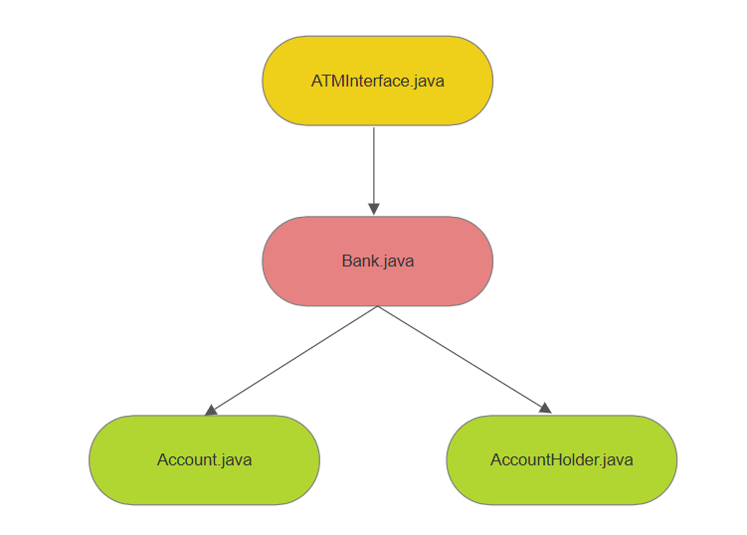
System Architecture
ATM Interface handles user input and flow
Bank manages all functionalities i.e: withdraw,deposit….
Account stores Balance, credit,debit amount.
AccountHolder holds UserId and PIN.

Slide 4
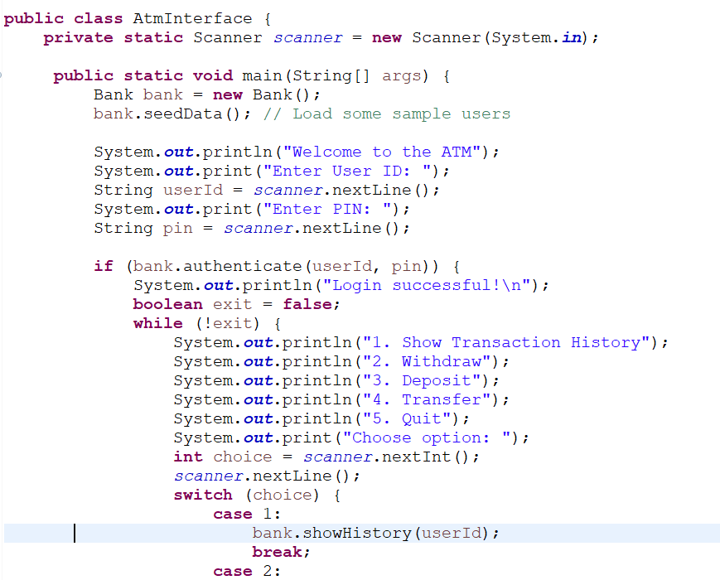
Class – ATMInterface.java(User interaction)
Menu with options using switch-case
Handles user input and delegates actions

Slide 5
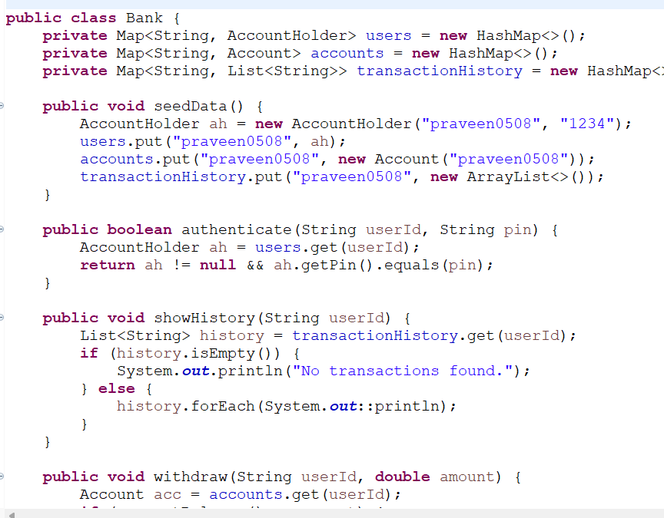
Class – Bank.java
Methods: seedData(),authenticate(),showHistory(),withdraw(),deposite()

Slide 6
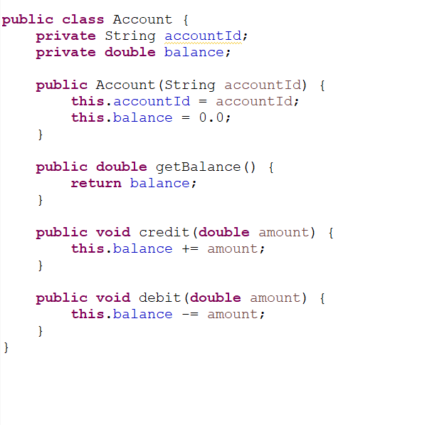
Class - Account.java
Attributes: accountId , balance
Methods: Account(),getBalance(),credit(),debit()

Slide 7
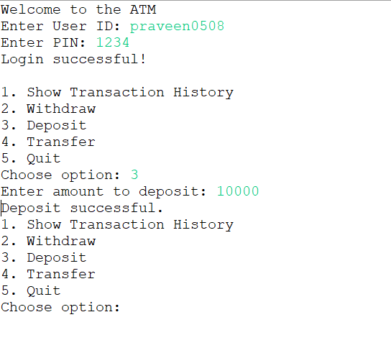
Output

Slide 8
Technologies Used:
Java (OOP) -Encapsulation: private vars, public methods
Reusability: logic separation
Collections (Map, List)

Slide 9
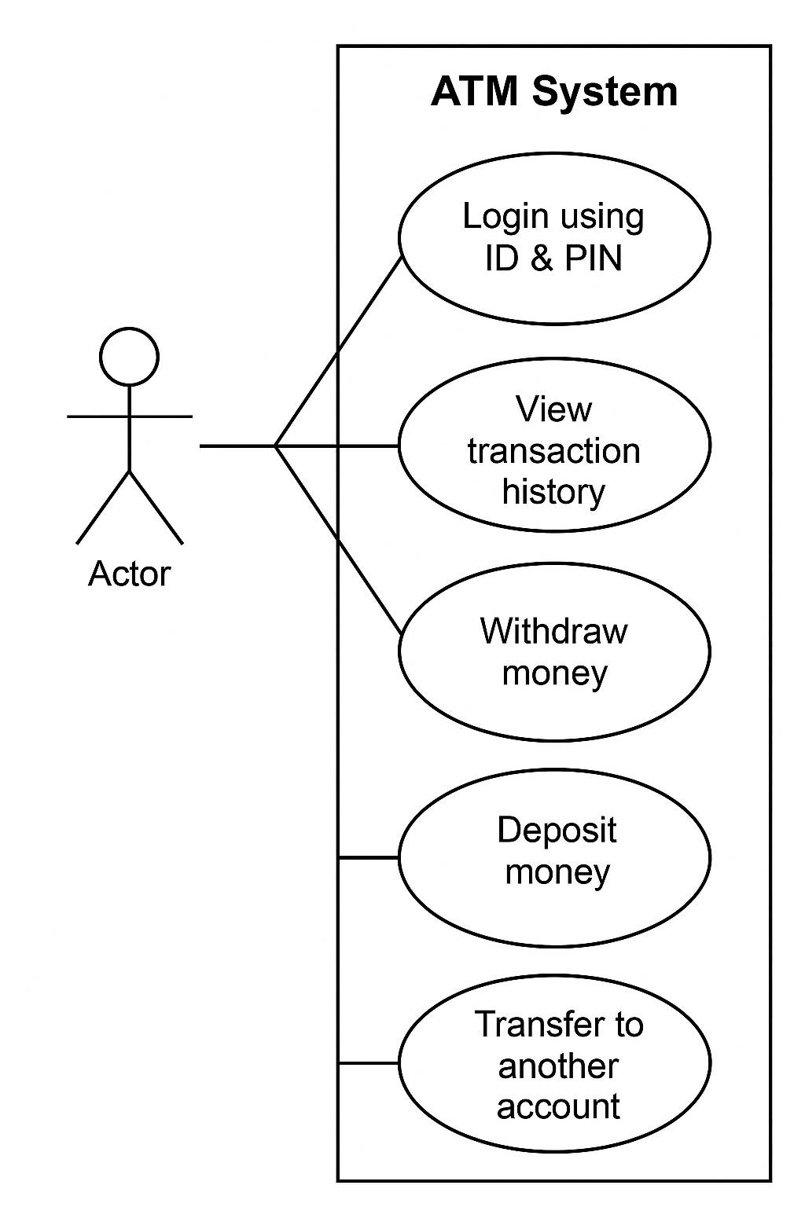
Use Case diagram

Slide 10
Conclusion
• Built a working console-based ATM system
• Applied Java fundamentals effectively

